Slide 1
Module 6
Women and Entrepreneurship
Artist: Victor Sheleg

Slide 2
Introduction
This sixth module of the six-part PEAK course offers tools and analysis to:
Understand why and how there is a gender gap in entrepreneurship.
Realize that women face special challenges in entrepreneurship that become more complicated in mountainous areas.
Identify the importance for women of Motivation, Skills, Empowerment, Networks.

Slide 3
LEARNING OBJECTIVES
At the end of this module,
you should be able to:
Acquire knowledge through studies on the gender gap in entrepreneurship.
Identify the special obstacles and challenges women face in entrepreneurship.
Recognize the additional difficulties deriving in the socioeconomic frame in mountainous regions.
Identify how women can be encouraged to entrepreneurship.
Build your personal development map to entrepreneurship.

Slide 4
Did you know?
One in ten women in work is self-employed, almost half the rate of self-employed men (17%).
PAY GAP: Women working full time in the U.S. are still paid just 83 cents to every dollar earned by men.
Female-run businesses are more inclined to learn from family or friends. Male entrepreneurs value learning from other businesses.
38 out of 141 economies in the Women, Business and the Law set out equal legal rights for women and men in key areas.
2% of CEOs are women.
In 18 countries, husbands can legally prevent their wives from working.
Women in Northern Africa hold less than one in five paid jobs in non-agricultural sectors.
more facts and studies
here
Pages 35-44

Slide 5
STEREOTYPES
Gender stereotypes
Maths, digital technology, financing are men’s skills.
Women are emotional, unable to lead and manage.
Women can’t have a career and be good mothers at the same time.
Women “take care”. Men “take responsibilities”.
Women aren’t capable of solving problems.
Women are good only in social type jobs: teacher, nurse, secretary, hairdresser etc.
Gender stereotypes
Shattering stereotypes
The curse of male-only business
Gender stereotypes
Want to learn more about gender stereotypes in entrepreneurship?
Click the links above!

Slide 6
Quiz gender gap: what do you know about it?
What is the percentage of female owned enterprises in EU-27 countries?
How much agricultural land do women own globally ?
How close we are to eliminate gender gap?
The payment gender gap is higher in:
We still need 50 years at least
a. 15%
a. 65%
a. Self - employment
b. 28%
b. Wage - employment
b. Very close. In 10 years max
b. 35%
c. 13%
c. Not even in 200 years from now
c. 25%

Slide 7
Quiz gender gap: answers
In EU-27 countries, only 25% of business owners with employees are women. In 2009 Eurobarometer study, 51% of men and 39% of women preferred to be self-employed than being employees.
Globally, women are just 13% of agricultural land holders. The rest, belongs to men.
It is higher in self-employment. A major factor for this is that women devote less time in the business, than men. In addition, women rely less in external finance than men
The World Economic Forum estimates that at the current rate of progress, it will take 267.6 years to close the economic gender gap.

Slide 8
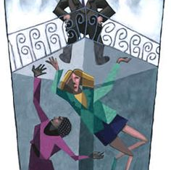
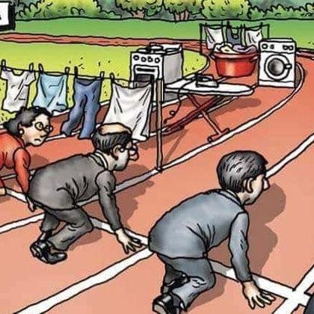
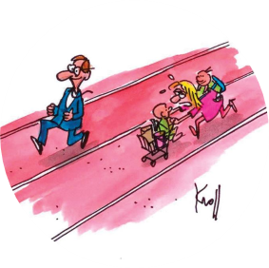
Challenges and obstacles women face
WORK – LIFE BALANCE
LABOUR MARKET SEGREGATION
GLASS CEILING
INVISIBLE BARRIERS
What is
Work – life balance
What is
Glass ceiling
What are Invisible barriers
What is
labour market segregation
or segmentation

Slide 9
Challenges and obstacles women face: Learn more
WORK – LIFE BALANCE
GLASS CEILING
INVISIBLE BARRIERS
LABOUR MARKET SEGREGATION
WORK – LIFE BALANCE
GLASS CEILING
INVISIBLE BARRIERS
LABOUR MARKET SEGREGATION
GLASS CEILING
INVISIBLE BARRIERS
WORK – LIFE BALANCE
GLASS CEILING
Click the links above!

Slide 10
Things are more difficult in mountains
More info
Why?
More info
More info
Less open
to new ideas or methods
More info
Lack of access to credit, loans, finance
Lower educational level
Less self-confidence
Hesitance in taking risks
Restricted access to information technology
More info
More info
More info
More info
Find relative studies here !
Click the more info links above!
Pages 50-62

Slide 11
How to overcome challenges and difficulties
KNOWLEDGE
SKILLS
INDEPENDANCE
FEMALE
EMPOWERMENT
MOTIVATION
ASK FOR HELP
FIND WHAT YOU LIKE:
HOBBIES
STUDIES
SEMINARS
TRAINING
FRIENDS
FAMILY
MENTORS
FUNDING PROGRAMMES
LOANS
MENTORING
SELF CONFIDENCE
FREEDOM

Slide 12
How to overcome challenges and difficulties
Find relative studies and material:
MOTIVATION
MOTIVATION
MOTIVATION
KNOWLEDGE SKILLS
KNOWLEDGE SKILLS
MENTORING
MENTORING
MENTORING
INDEPENDENCE OF WOMEN
INDEPENDENCE OF WOMEN
INDEPENDENCE OF WOMEN
FEMALE EMPOWERMENT
MENTORING AND EMPOWERMENT
FUNDING
FUNDING
ASKING FOR HELP
ASKING FOR HELP
ASKING FOR HELP
ASPIRATION
ASPIRATION
TRAINING AND SUPPORT
BUILDING CONFIDENCE

Slide 13
NETWORKING is very important.
Why?
A safety net around women creating familiar environment.
Helps women overcome their fears, find paths to enhance their abilities and empower themselves.
Helps to find inspiration through other women.
Essential for connection and overcoming the barriers imposed in mountain regions.

Slide 14
Networks and Platforms to Support and Help Female Entrepreneurship
Ambassadors Network, with 270 successful entrepreneurs from 22 European countries.
LINK: https://ec.europa.eu/docsroom/documents/17322/attachments/1/translations
WEgate platform _ for women of all ages who want to start, run and grow a business.
LINK: https://www.wegate.eu/
European network to promote women's entrepreneurship (WES) _ a policy network with members from 31 European nations.
LINK: https://uia.org/s/or/en/1122268925

Slide 15
Networks and Platforms to Support and Help Female Entrepreneurship
European Network of Mentors for Women Entrepreneurs _ The Mentors Network provides advice and support to women entrepreneurs on the start-up, management and growth of their businesses in the early phases.
LINK: https://ec.europa.eu/docsroom/documents/10306/attachments/1/translations
WOMEN ENTREPRENEURSHIP PLATFORM (WEP) _ European network association representing, promoting, supporting, and advocating on behalf of women entrepreneurs across Europe.
LINK: http://www.womenentrepreneurshipplatform.org/
The WiRE program _ aiming at promoting and cultivating women entrepreneurship and innovation in rural, regional and remote (RRR) Australia, through delivering an integrated capacity building program.
LINK: https://www.wireprogram.com/

Slide 16
Be inspired by young women !
who created their own business in mountain / rural areas
Dimitra Karani
Theodora Tzalonikou
Íris Ragnarsdóttir Petersen
Beekeeper
Yoga teacher,
Environmentalist
Agrafa, Greece
Mountain and glacier guide
Grevena, Greece
Svínafell, Öræfi,
South-East Iceland
Click on names and listen to young women entrepreneurs describing their experience

Slide 17
Be inspired by young women !
who created their own business in mountain / rural areas
Erin Charters
Vasiliki Todi
Antonietta Casiero
Cycle Luss bike hiring company
Luss, Scotland
Juvara winery
Manager at guest house
Lucera, Italia
Metsovo, Greece
Click on names and listen to young women entrepreneurs describing their experience

Slide 18
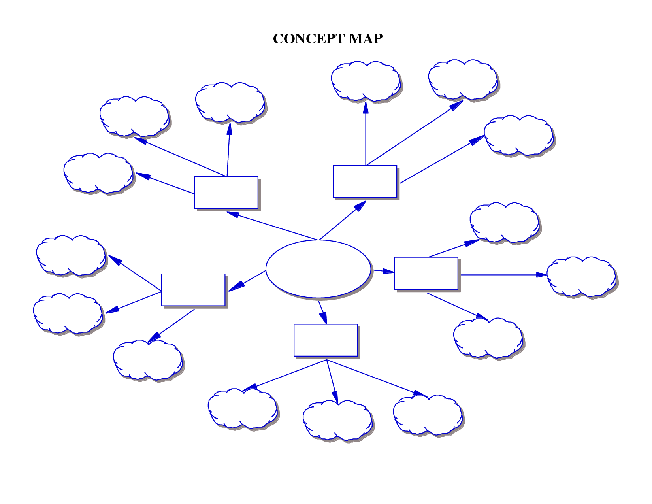
activity
Mind mapping
subtopic
subtopic
This is a technique to help you develop and organize any idea or topic.
It helps to understand a concept by breaking it down to its component parts.
It is an expansive and flexible structure.
Core elements: key central topic, expansive tree structure, use of keywords rather than long sentences
subtopic
Supporting
idea
Supporting
idea
subtopic
subtopic
Central
topic
Supporting
idea
subtopic
Supporting
idea
Supporting
idea
subtopic
subtopic
subtopic

Slide 19
Mind Mapping
An exercise to explore yourself
which you can apply to any kind of topic
Create the supporting ideas at the first level
i.e. sources of low self confidence: family, studies, work, social relations
Step 1
start
Define your central topic
i.e. Low self confidence to start my own business
Step 2

Slide 20
You can go on expanding all or some subtopics even more if it helps to focus on sources
Step 4
Step 6
Expand each one of the ideas in subtopics
i.e. define why your family is a source of low self confidence (attitudes, opinions, beliefs etc)
Define which of all subtopics hold gender bias
or are stereotypes
Step 5

Slide 21
Define your real abilities and deficiencies
regarding your entrepreneurship idea.
Step 8
end
Step 7
By knowing your deficiencies you can now focus on working on them – make use of all available material

Slide 22
Mind mapping
You can use pen and papers to apply the mind mapping technique
You can also use online material here
You can use mind mapping to explore anything you can think of !
(i.e. you can use it to explore the benefits that your idea will bring to local communities, or how other young people in your area could be inspired)

Slide 23
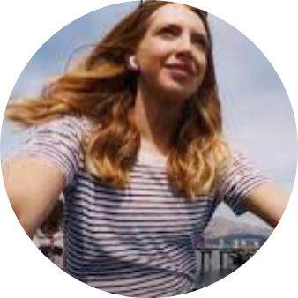
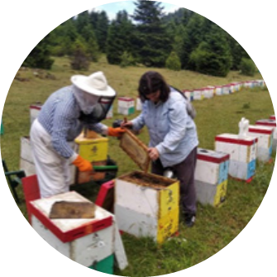
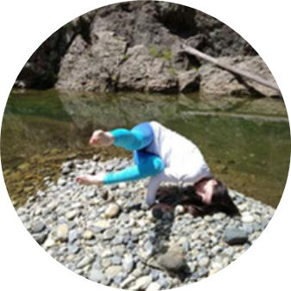
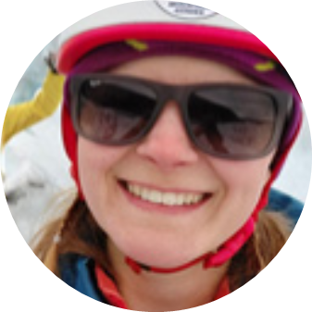
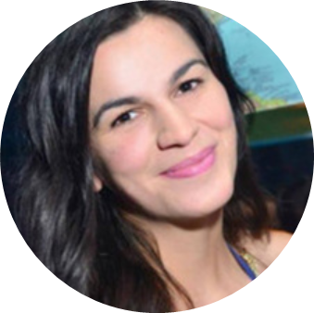
Keep in mind that:
Creation, support and promotion of female entrepreneurship has been a decisive factor that changed the lives of many women.
Especially the young ones.

Slide 24
Links to PEAK:
Well done!
You have completed all of the six Modules of PEAK !
YouTube: https://www.youtube.com/@peakentrepreneurs2892/videos
TikTok: https://www.tiktok.com/@peakentrepreneurs
Instagram: https://www.instagram.com/peak.entrepreneurs/
Facebook: https://www.facebook.com/PeakEntrepreneurs

